Slide 1
1.3 JD+ and R
ESTP Training
05-07 October 2026

Slide 2
1. Main requirements
RJDemetra
  Java runtime (>=11)
  R (>= 3.1.1)
  rJava (>= 0.9-8)
rjdverse
  Java runtime (>=17.0)
  R (>= 3.6.0)
  rJava (>= 1.0-6),
  RProtoBuf (>= 0.4.17)

Slide 3
2. Technical design of Rjdemetra (v2)
Java
R, native
JTsToolkit.jar
Java
jdr.jar
rJava
R
RJDemetra package
Java
SACruncher
R
R-Studio
…
Java
JDemetra GUI

Slide 4
3. Technical design of rjdverse (v3)
Java
R, native
demetra-xxx.jar
Java
Demetra-xxx-r.jar
rJava,
RProtobuf
R
RJD3xxx package
R
R-Studio
…
Java
JDemetra GUI

Slide 5
4. rjdverse: Overview (https://github.com/rjdverse)
rjd3jars
rjdxjars
rjd3sts
rjd3tramoseats
rjd3x13
rjd3toolkit
rjd3highfreq
rjd3providers
rjd3stl
rjd3filters
rjd3workspace
rjd3revisions
rjd3bench
rjd3nowcasting
Design similar to the Java libraries !
rjd3cycle

Slide 6
4. rjdverse: Overview (Java libraries)
rjd3jars
rjdxjars
rjd3sts
rjd3tramoseats
rjd3x13
rjd3toolkit
rjd3highfreq
rjd3providers
rjd3stl
rjd3filters
rjd3workspace
rjd3revisions
rjd3bench
rjd3nowcasting
Design similar to the Java libraries !
rjd3cycle

Slide 7
4. rjdverse: Overview (main packages for SA)
rjd3jars
rjdxjars
rjd3sts
rjd3tramoseats
rjd3x13
rjd3toolkit
rjd3highfreq
rjd3providers
rjd3stl
rjd3filters
rjd3workspace
rjd3revisions
rjd3bench
rjd3nowcasting
Design similar to the Java libraries !
rjd3cycle

Slide 8

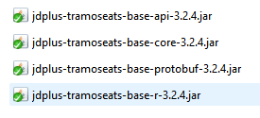
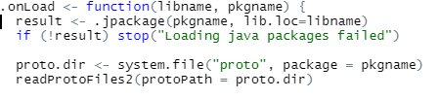
rjd3tramoseats
Proto files
inst
Java package
R files

Slide 9
5. Objectives of R packages
High-level functions with most common results
Many low-level functions
  Advanced users
  Research
  Training
  Additional tools

Slide 10



6. Installing the packages
If need be, referencing the correct java runtime (>= 21.0)
  Set your JAVA_HOME variable (tip: use the jre provided with JD+)
Install the various packages (internet access needed)
  Install from CRAN for the main packages
  # install.packages("remotes")
  remotes::install_github("rjdverse/rjd3workspace@*release")

Slide 11
6. Installing the packages (cont)
remotes::install_github("rjdverse/rjd3filters@*release")
remotes::install_github("rjdverse/rjd3sts@*release")
remotes::install_github("rjdverse/rjd3highfreq@*release")
remotes::install_github("rjdverse/rjd3x11plus@*release")

Slide 12
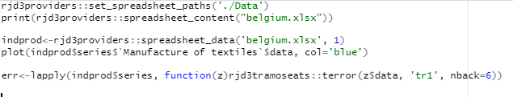
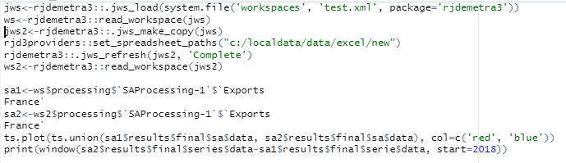
7. Examples
Reading Excel files (JD+-like) and detecting errors
Refreshing a workspace

Slide 13
8. Final remarks
Many features provided in the Java libraries can be called from R
Most tasks can be automated
Many additional tools could be developed in R

